Slide 1
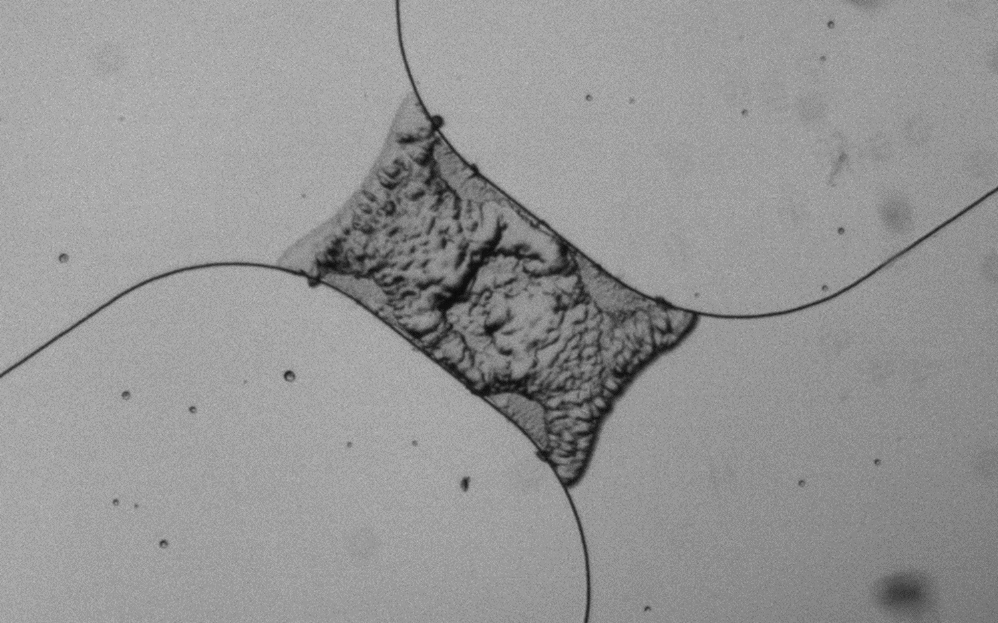
Inertial Focusing for Thermal Micro-Pumps
Shiv Srivastava
University of Colorado at Boulder
Advisors: Brandon Hayes and Robert MacCurdy
Notes:
Put current work slide (video of metal casting and picture of hydroperm molds)
2. Enlarge slide numbers
3. Mention metals earlier on
4. Add slide on rotor and stator overview
5. Condense intro
6. Gearbox explosion video
7. Put videos casting

Slide 2
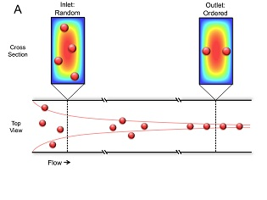
Introduction
Microfluidics definition: microfluidics is the study and manipulation of fluid flow at the sub millimeter scale.
Inertial Focusing: Inertial focusing is a phenomenon where suspended particles migrate across streamlines and focus at well-defined equilibrium points of the cross section. There is a necessity of large velocity gradients to influence particles and fluids while a laminar flow is maintained.

Slide 3
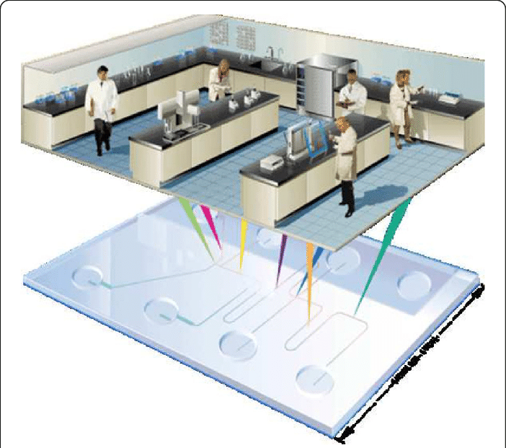
Motivation
Why do we care about this project?
Lab on a chip technology is a promising application of microfluidics.
Inertial Focusing can be used for cell sorting and filtration systems on the micrometer scale.

Slide 4
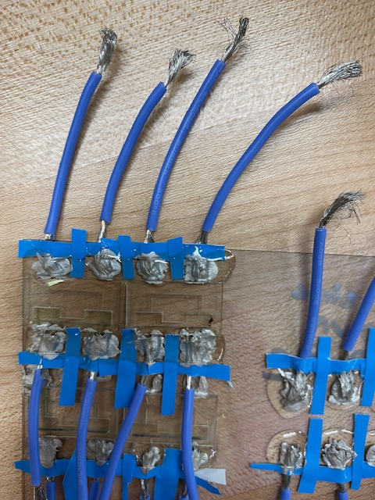
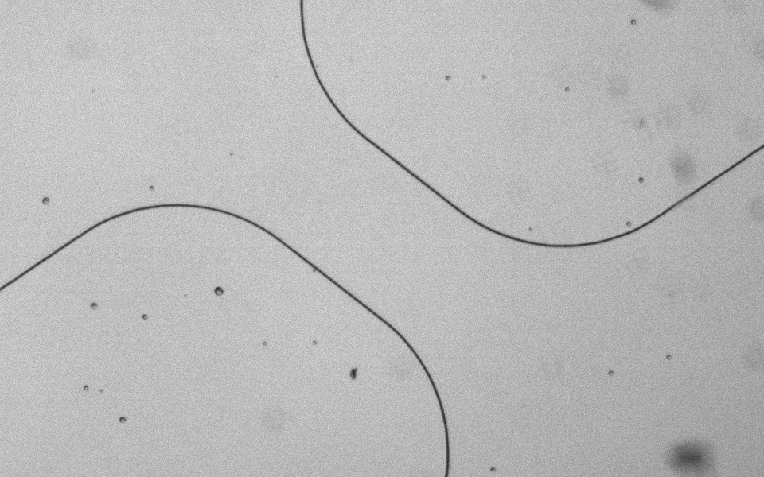
Process over the Summer
Manufacture high power resistors on ITO glass.
Fabricate microfluidic devices using the resistor as a heat source and incorporate a reservoir and channel.
Find correct voltage setting to test the working of the device and attempt to create laminar flows within the channel in order to observe Inertial focusing.

Slide 5
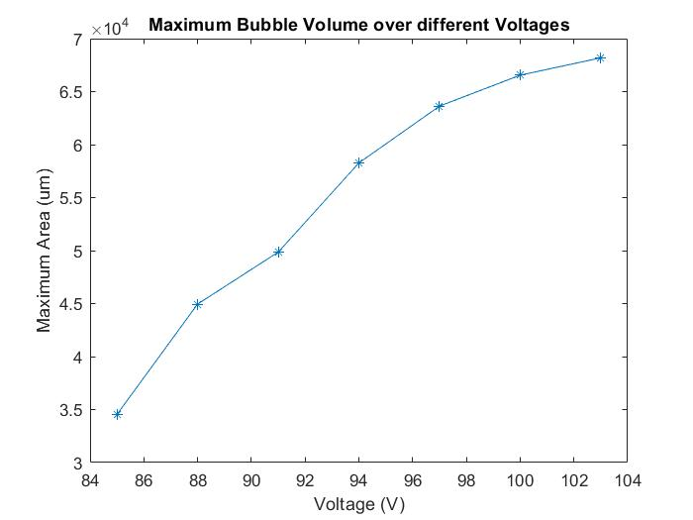
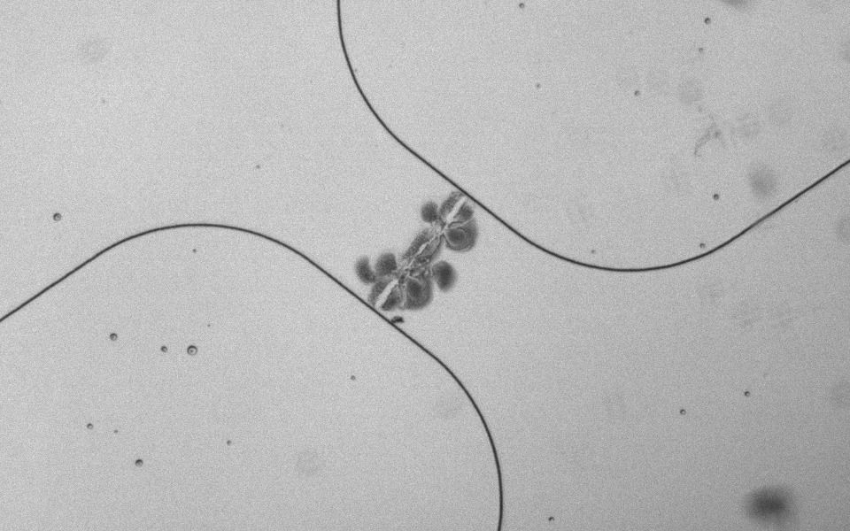
Bubble Test
The bubble test is the first test carried out to observe the working of the resistor. The bubble is viewed under a high-speed camera and the voltage at which peak bubble volume occurs is noted.

Slide 6
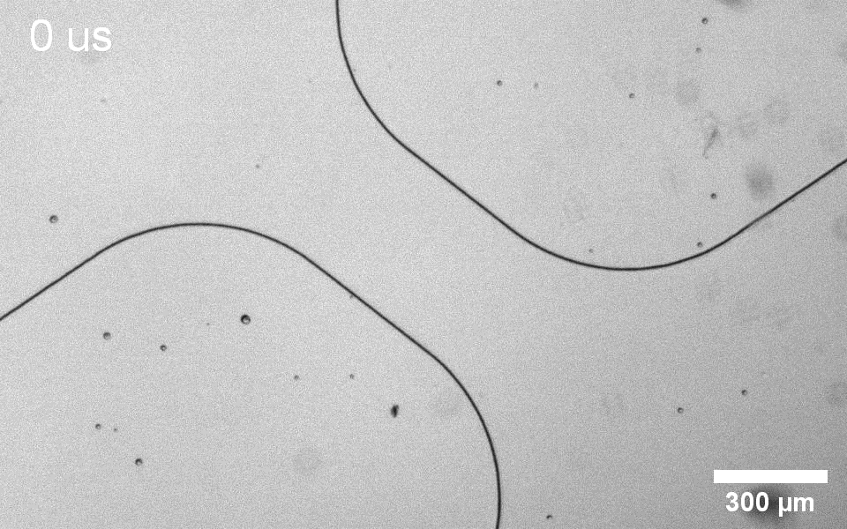
Bubble Expanse and Collapse

Slide 7
Fluorescent Particle Test
Fluorescent particles are injected into the reservoir and their motion through the channel is observed under blue LED light.
The particle sizes range either between 1 to 5 um or 10 to 15 um.
A single resistor is fired, and the bubble draws the particles into the channel.
A particle tracking software is used to determine the flow properties.

Slide 8
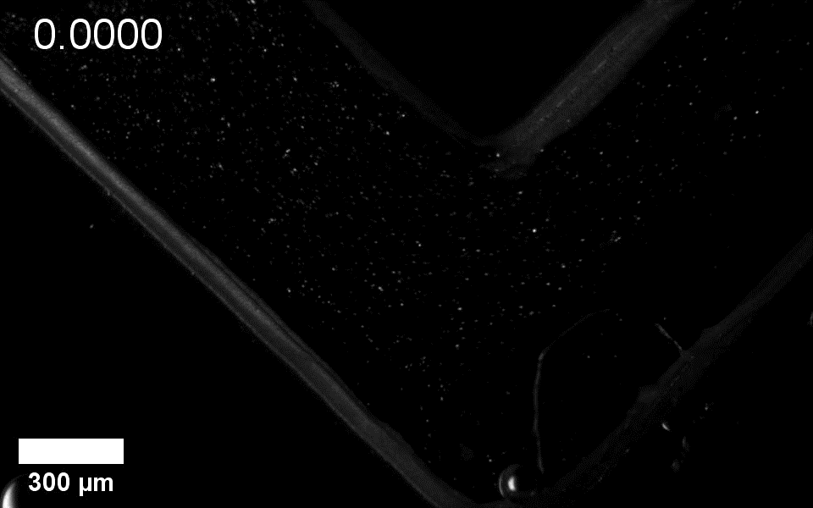
Fluorescent Particle Test
(Time in us)

Slide 9
Two-Resistor Test
The final test to observe inertial focusing.
Both resistors in the channel fire with a short interval of time in between.
Both bubbles cause a flow through the channel, ideally no net particle motion should be observed.
At the right flow rates and particle size, inertial focusing can be observed.

Slide 10
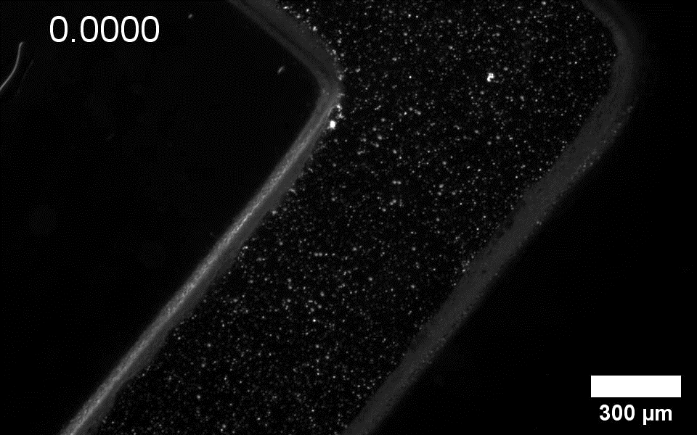
Two-Resistor Test
(Time in us)

Slide 11
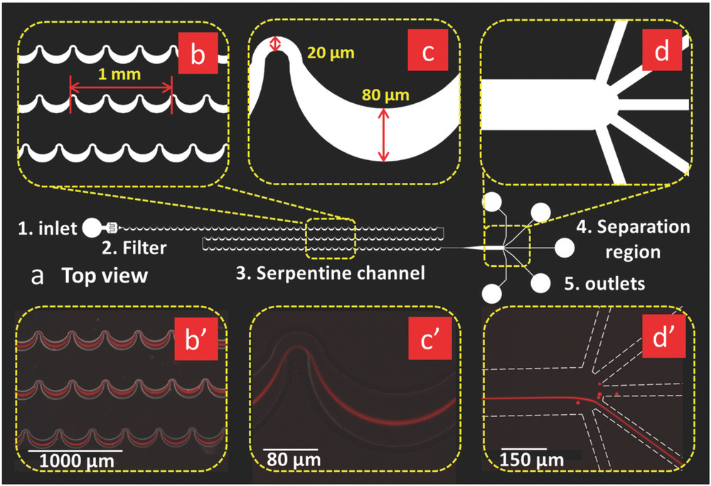
Future Research and Challenges
In order to observe inertial focusing, the particle size must not be too small as compared to the channel length. New particles and channel sizes could be tested.
The most common problem that occurred during the particle tests was that the particles would settle to the bottom and stick to the glass. Neutrally buoyant particles could be tested.
Different shapes of channels could be used.

Slide 12


Acknowledgements
Special thanks to Brandon Hayes, Professor Robert MacCurdy and the other members of Maclab.
This project was funded by the Engineering Excellence Fund (EEF).

Slide 13
Thank You!
Questions?

